Slide 2


Slide 3
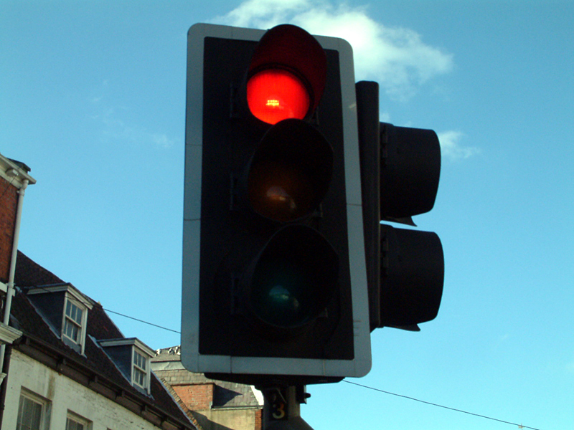

Slide 4
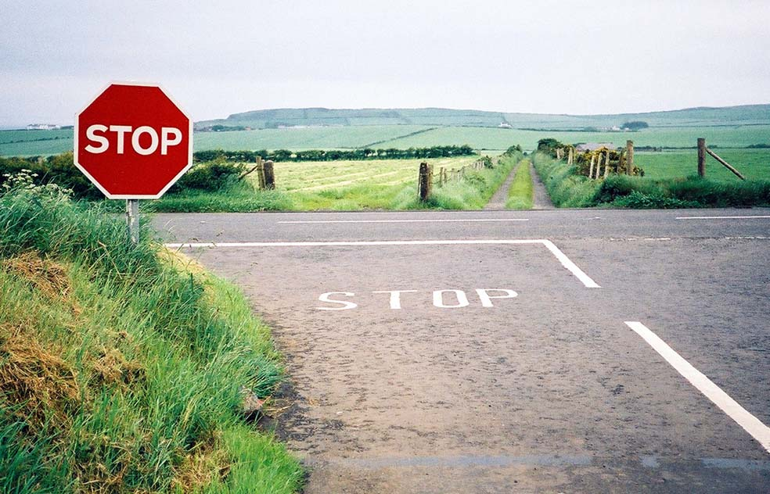

Slide 5
STOP!

Slide 6
S
ORRY

Slide 7
T
HANK
YOU

Slide 8
O
THERS

Slide 9
P
LEASE

Slide 10
SORRY
THANK YOU
OTHERS
PLEASE

