Slide 1
Thanks!

Slide 2
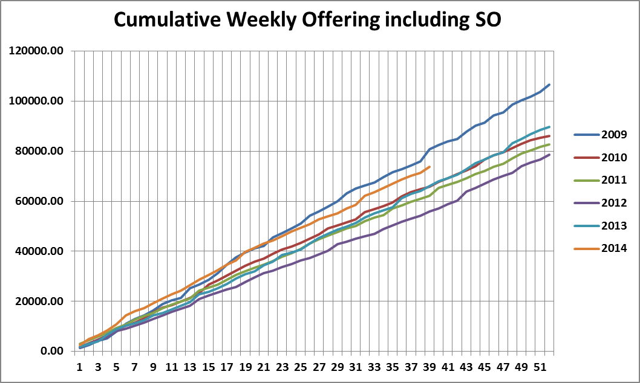

Slide 3
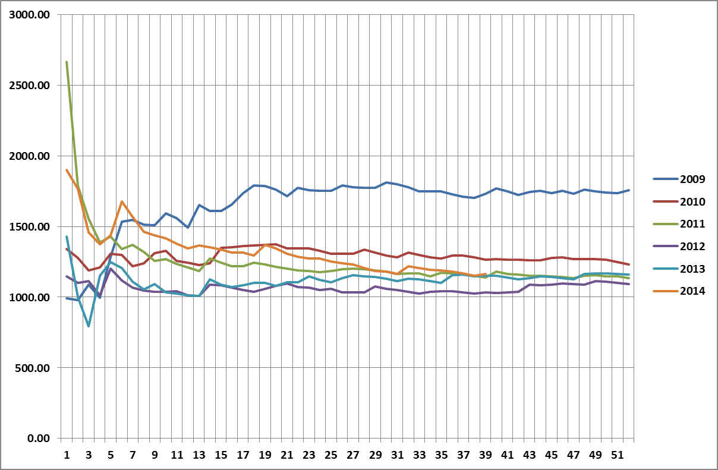

Slide 4
