Slide 2



Slide 3
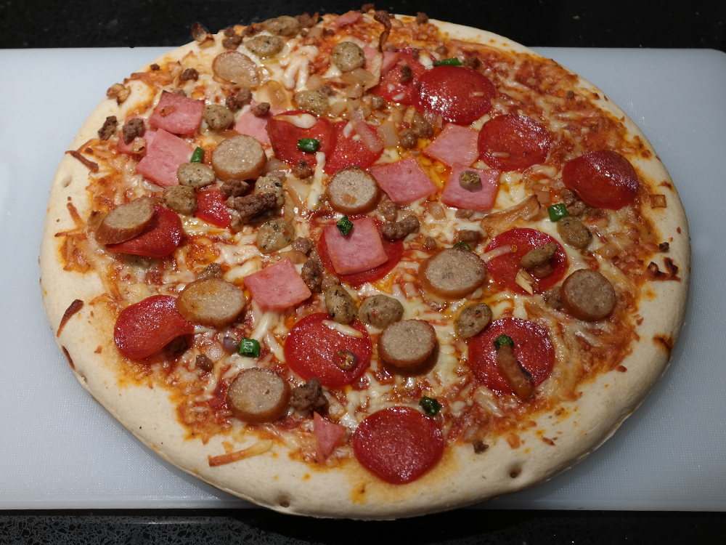

Slide 4

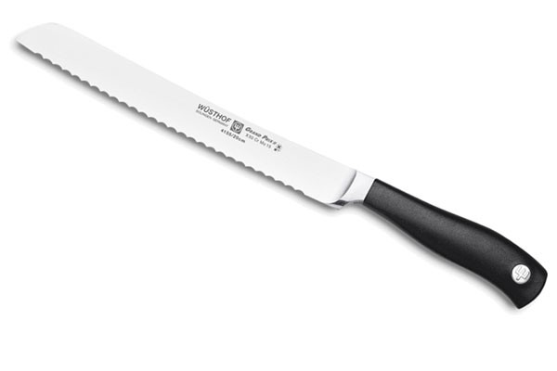

Slide 5
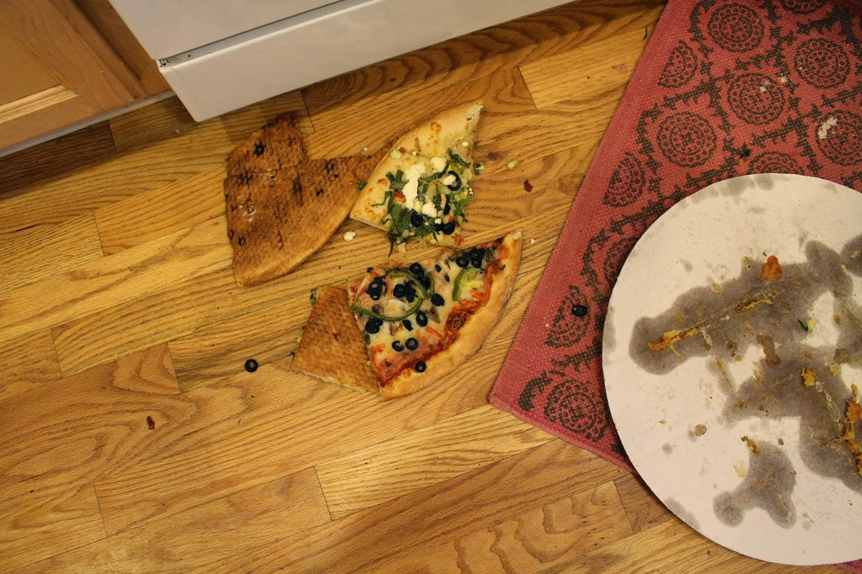

Slide 6
FIVE
SECOND
RULE!

Slide 7




Slide 8
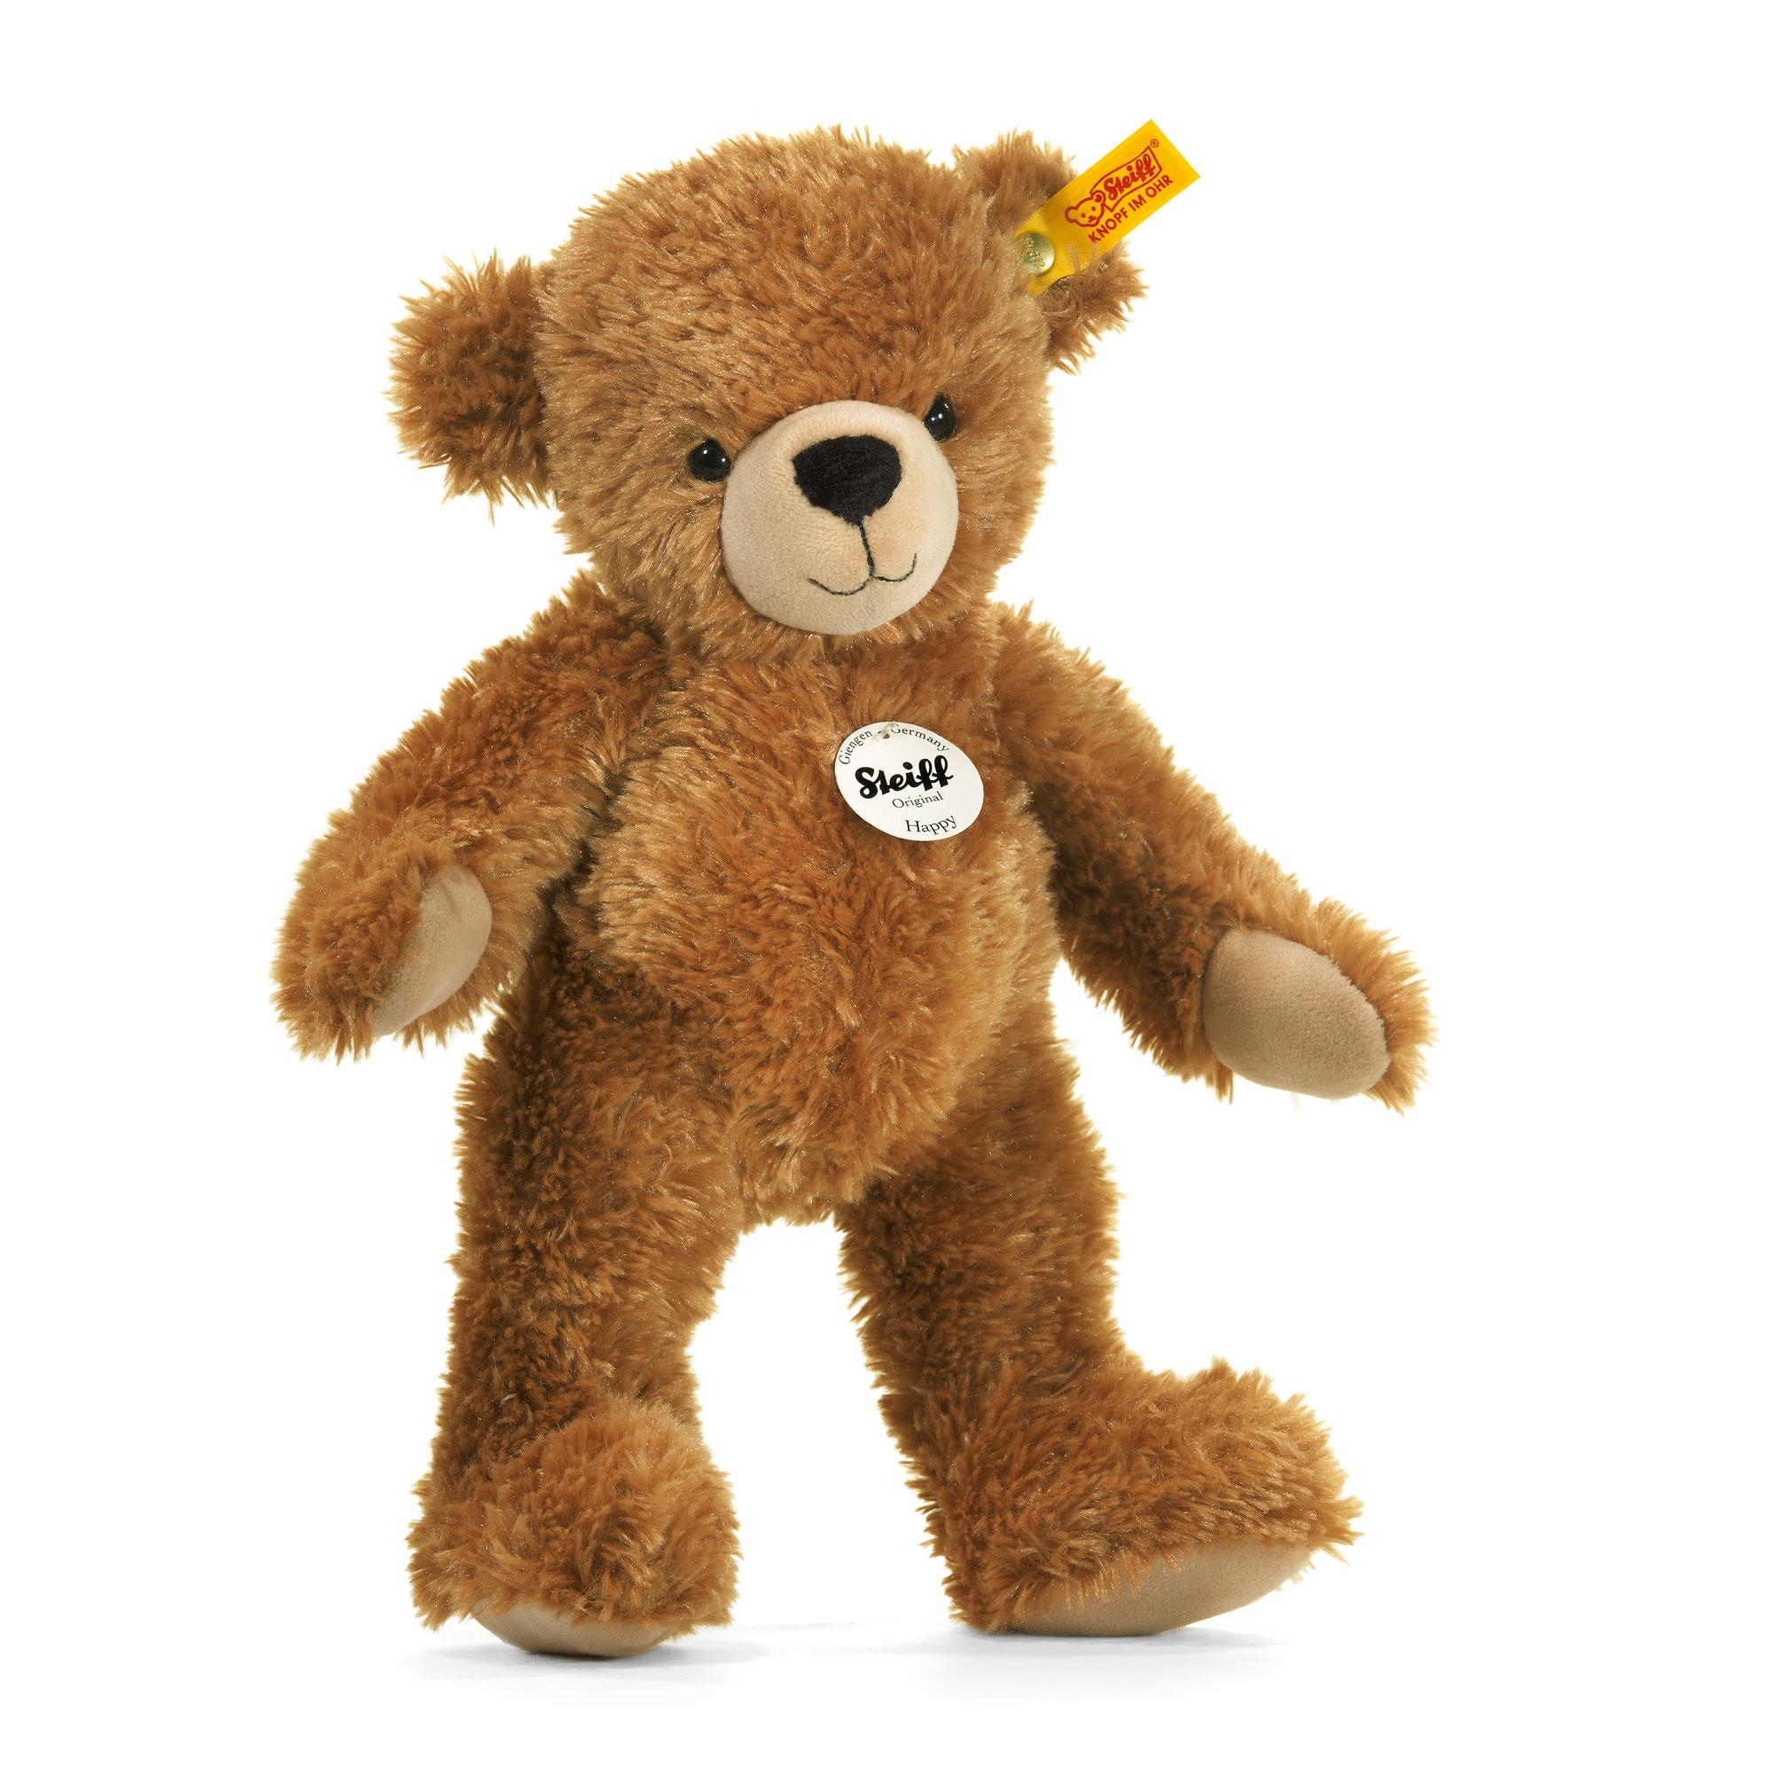

Slide 9
I knew it was wrong…
…but I did it anyway
I made an excuse
My previous experiences hadn’t been too bad
I had time to change my mind…
…which I didn’t take
So I suffered – it was a direct consequence of my actions
Eventually I was restored

Slide 10
I knew it was wrong…
…but I did it anyway
I made an excuse
My previous experiences hadn’t been too bad
I had time to change my mind…
…which I didn’t take
So I suffered – it was a direct consequence of my actions
Eventually I was restored

Slide 11
FIVE
SECOND
RULE!

