Slide 1
Cash paid for hideous mistakes
Iain Row
Visual Realms Ltd

Slide 2
“The man who never made a mistake never made anything”
Robert Brandon

Slide 3
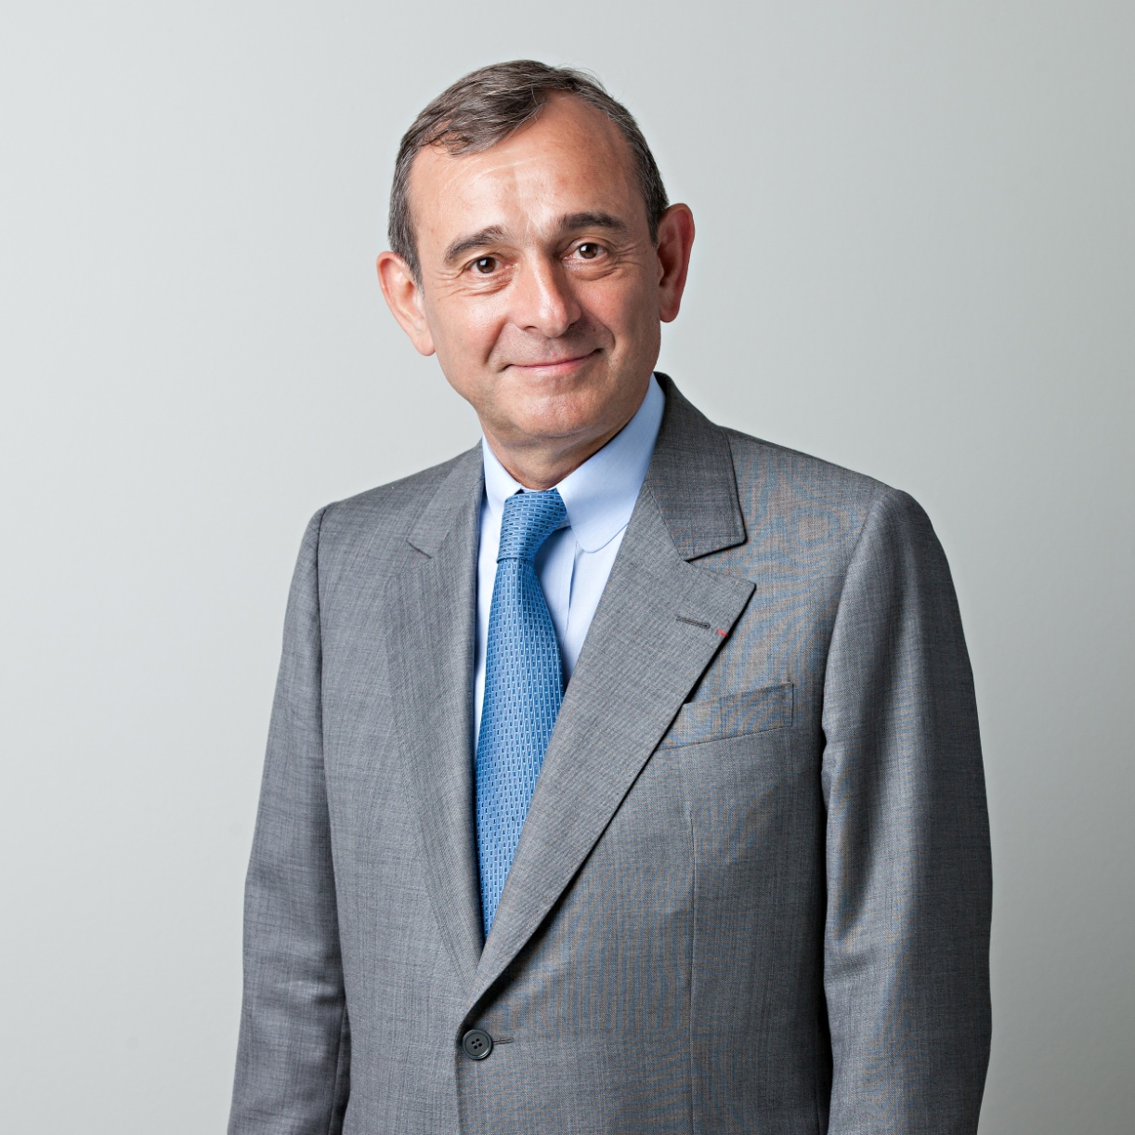


Slide 4
“So how does it work?”
All of you

Slide 5
“Time for a demo”
Iain Row

Slide 6
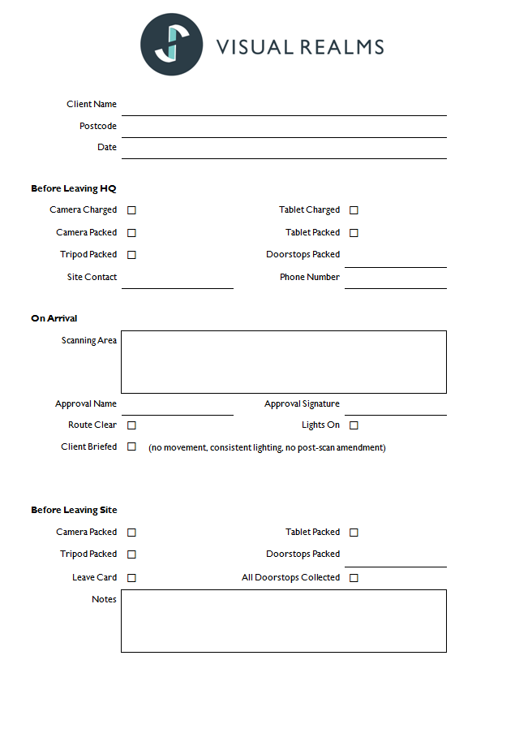

Slide 7
