Slide 1
ten commandments
for the web in 2018
Iain Row – Prominent Media Ltd

Slide 2

Thou shalt put the web in its place
?
??

Slide 3

Thou shalt have a joined-up strategy

Slide 4
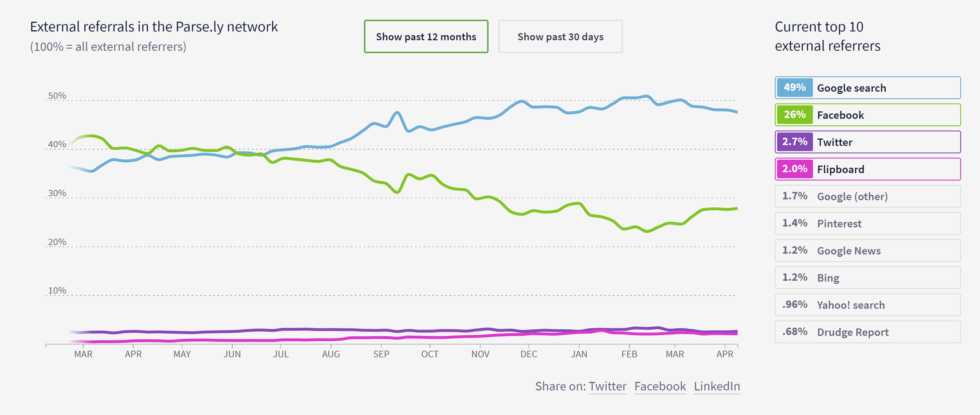
Thou shalt respect Google

Slide 5

Thou shalt respect users even more

Slide 6
Thou shalt be mobile first

Slide 7
Thou shalt not forget desktop users

Slide 8
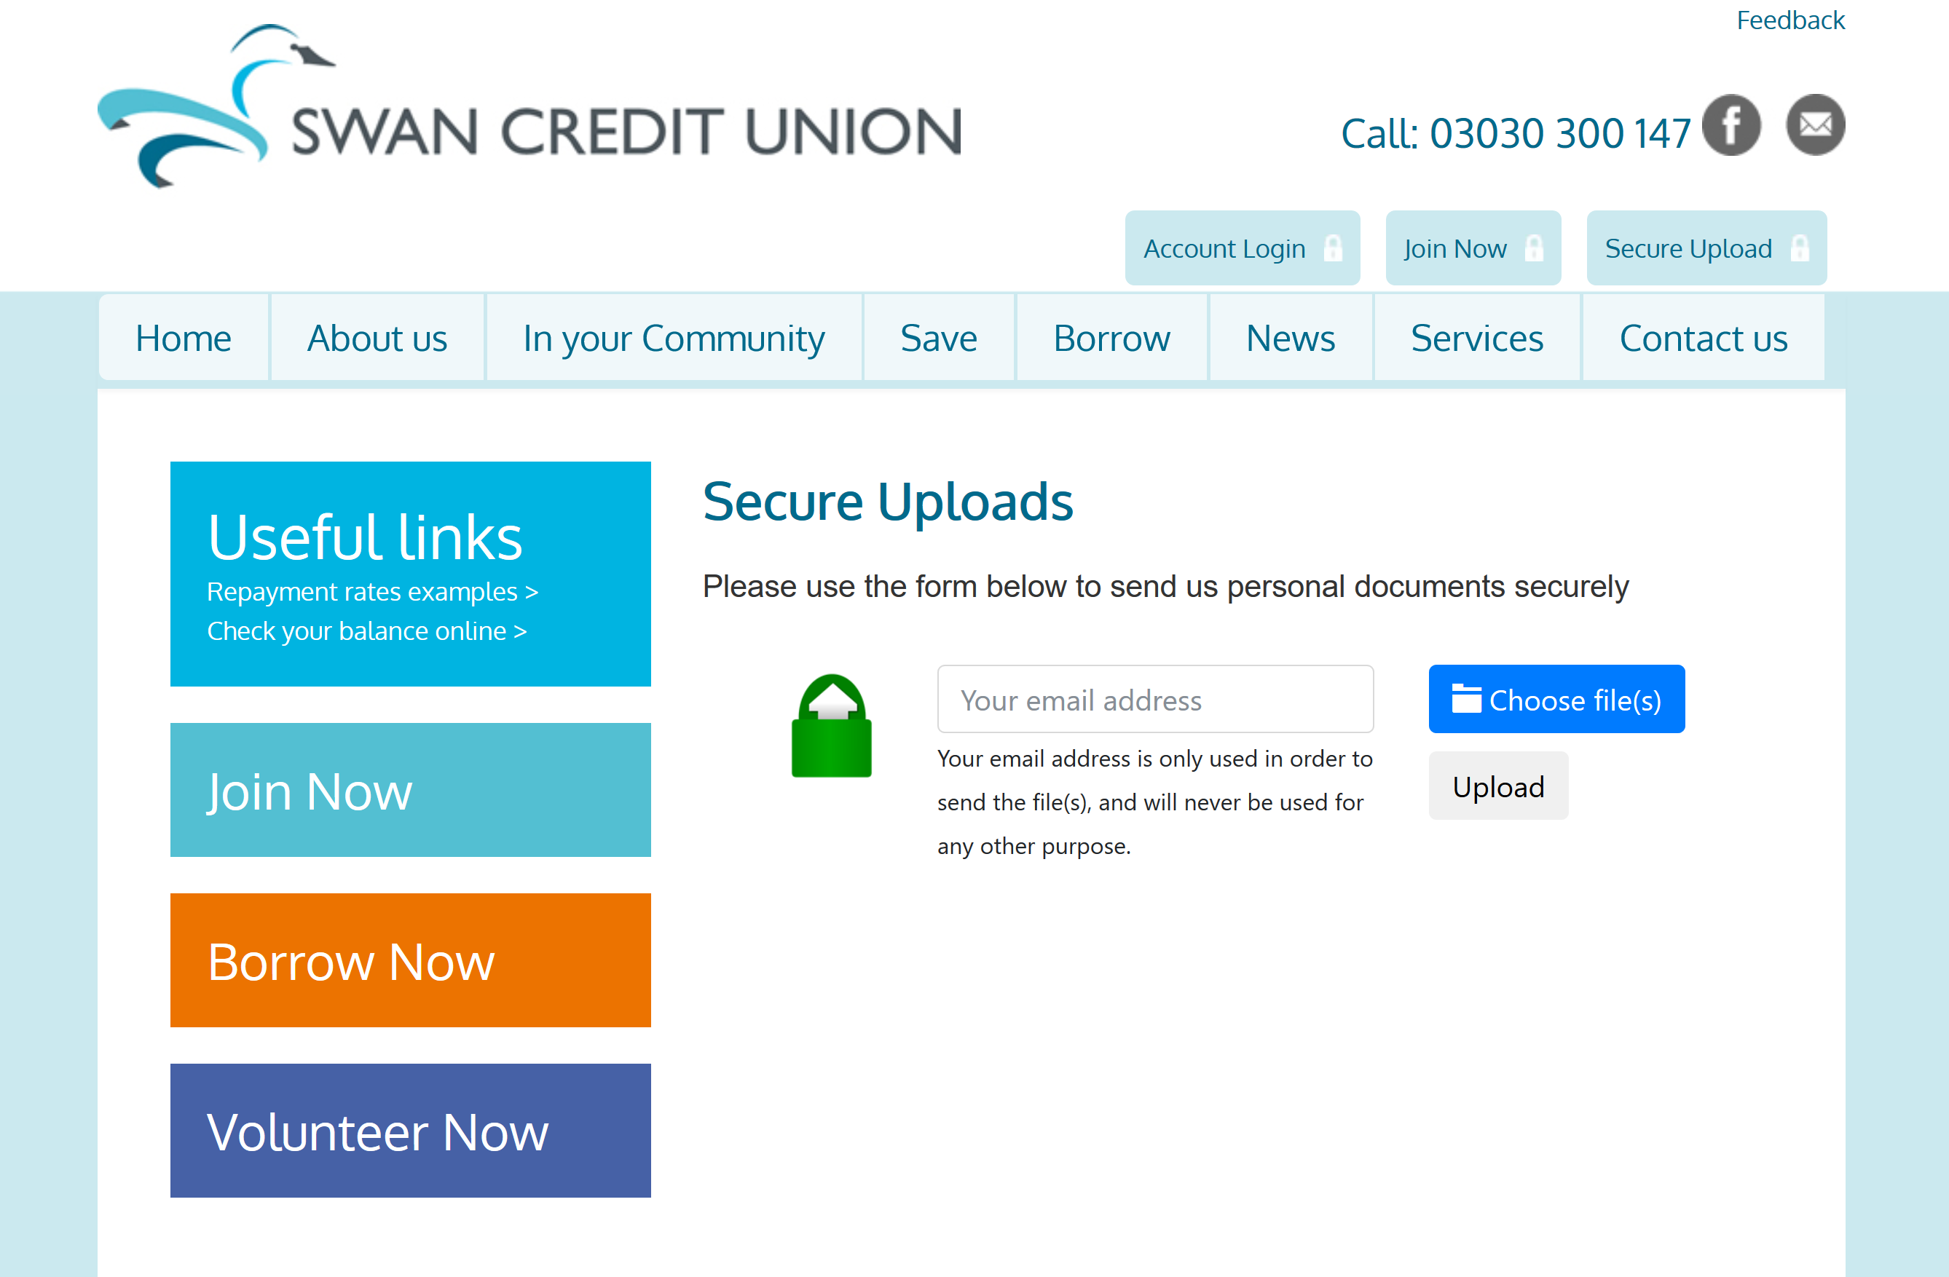
Thou shalt add massive value

Slide 9


Thou shalt expect zero tolerance

Slide 10
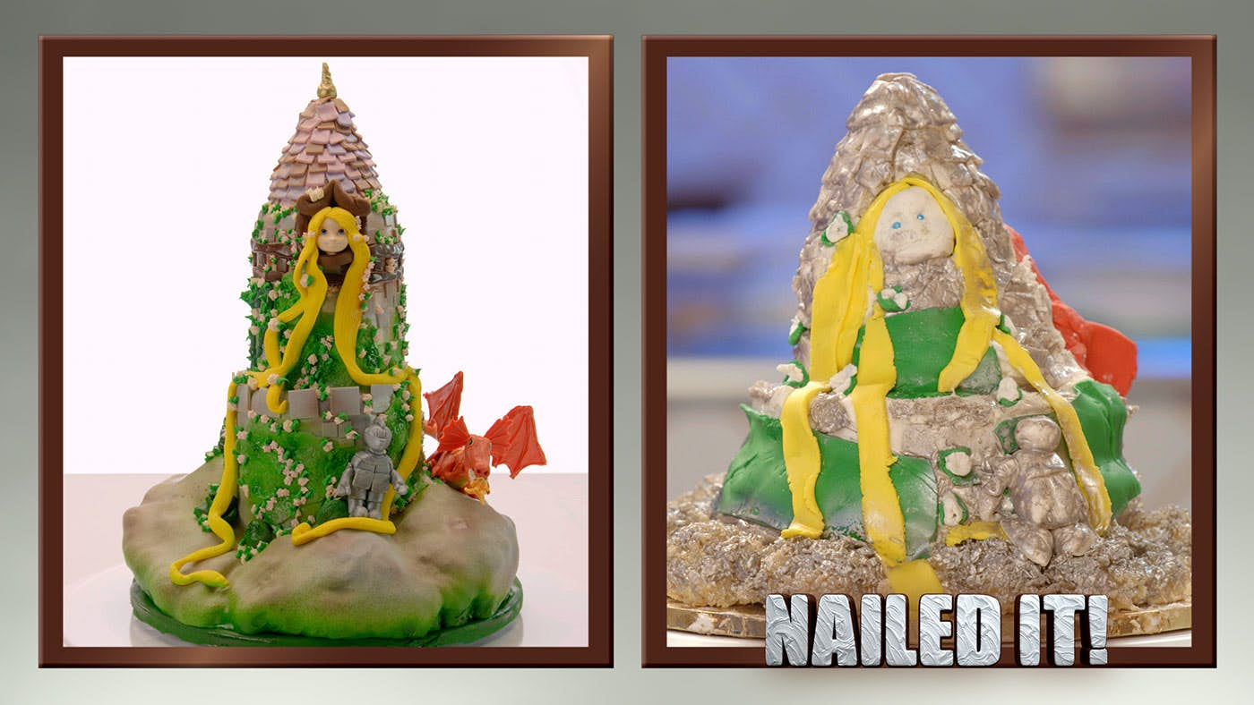
Thou shalt engage a professional

Slide 11
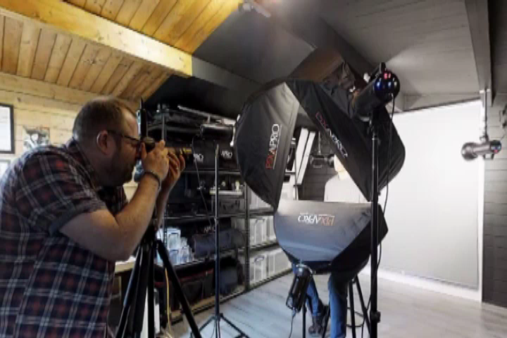
Thou shalt work hard for the WOW factor

Slide 12
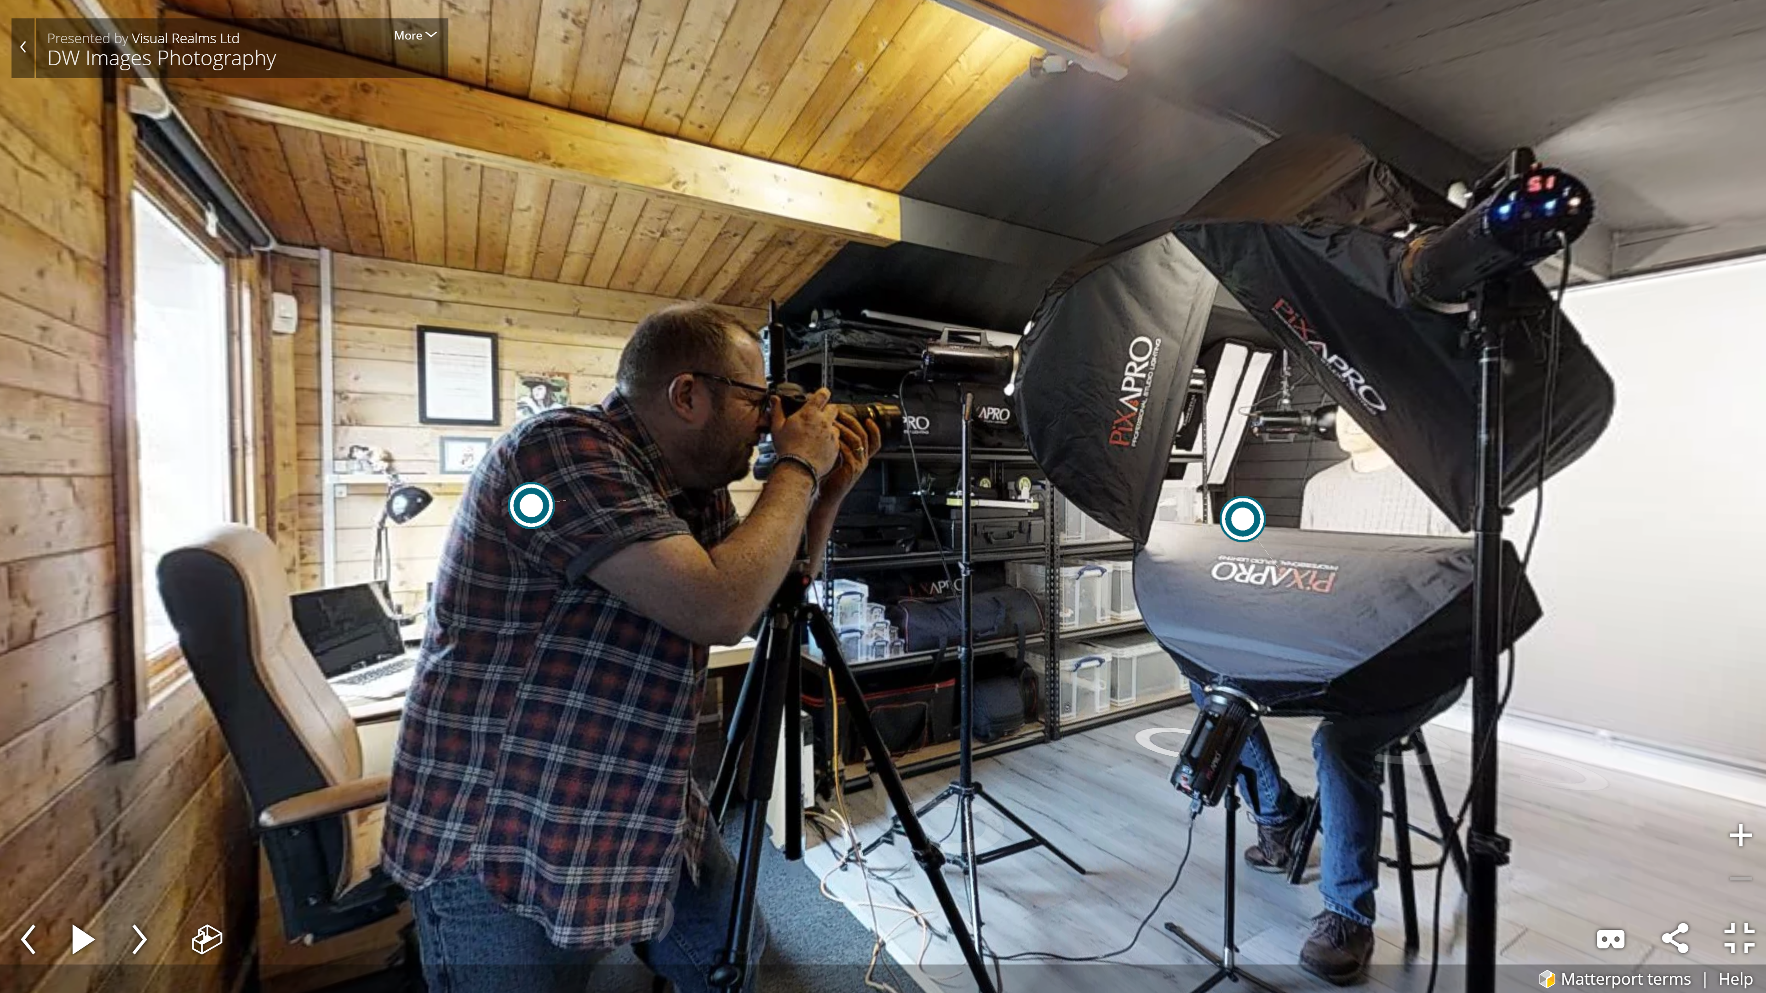
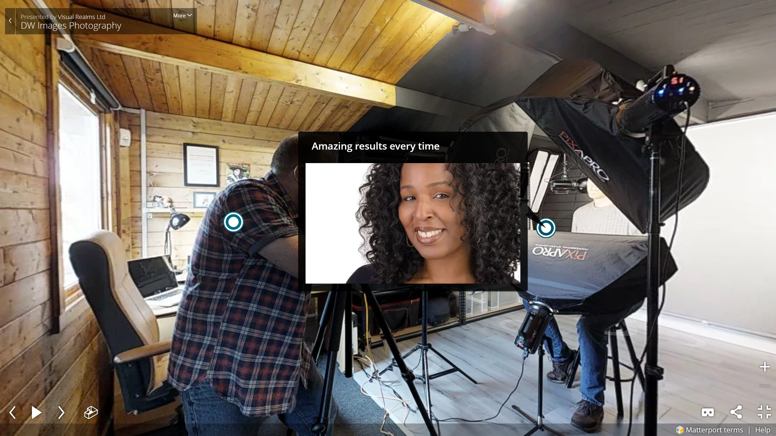
Thou shalt work hard for the WOW factor

Slide 13
ten commandments
Thou shalt put the web in its place
Thou shalt have a joined-up strategy
Thou shalt respect Google
Thou shalt respect users more
Thou shalt be mobile first
Thou shalt not forget desktop users
Thou shalt add value
Thou shalt expect zero tolerance
Thou shalt engage a professional
Thou shalt work hard for the wow factor

Slide 14
thank you
prominentmedia.com
visualrealms.co.uk
sslupload.co.uk

